Slide 1
Sales Performance Analysis of Walmart Stores
Using Advanced MYSQL Techniques

Slide 2
Introduction
Walmart, an American multinational retail corporation that operates a chain of hypermarkets in the United States and 23 other countries.
Walmart wants to use historical sales data to improve its sales strategies.
I’ve used MySQL queries to analyze data on different branches that include customer types, payment methods, and product lines to answer questions about sales, customer behavior, and product popularity.

Slide 3
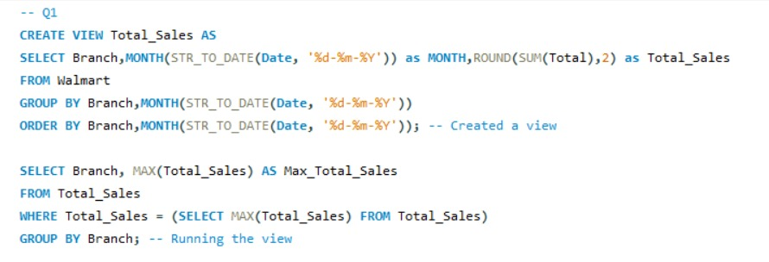

Identifying the Top Branch by Sales Growth Rate

Slide 4
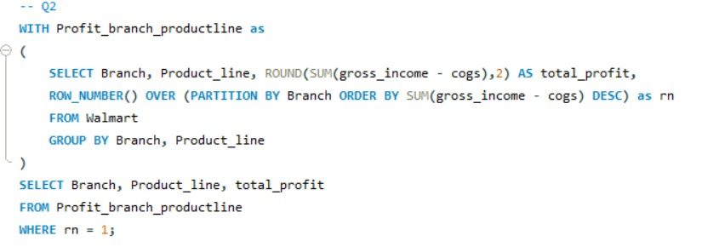
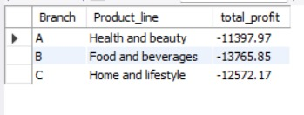
Finding the Most Profitable Product Line for Each Brand

Slide 5
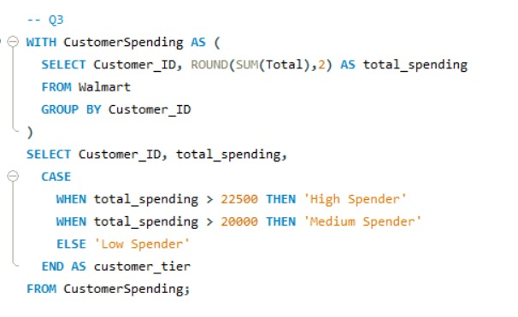
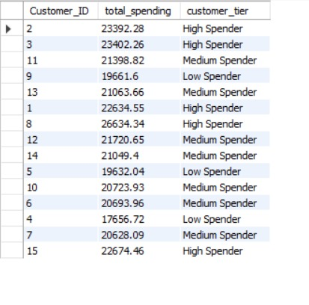
Analysing Customer Segmentation Based on Spending

Slide 6
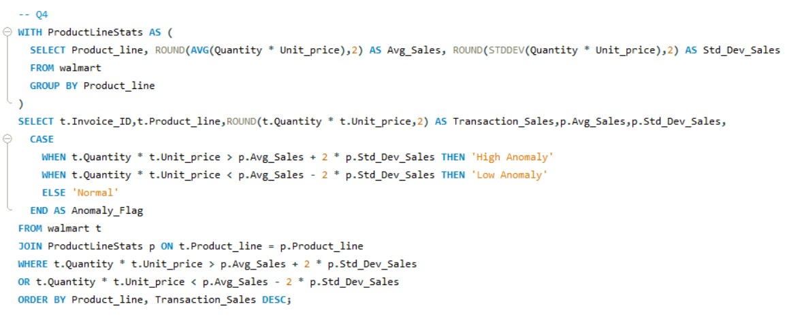
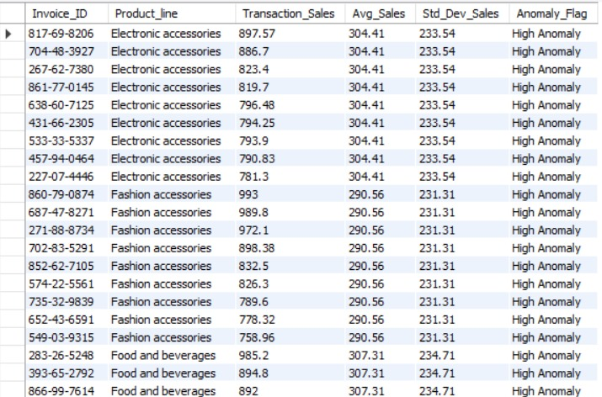
Detecting Anomalies in Sales transactions

Slide 7
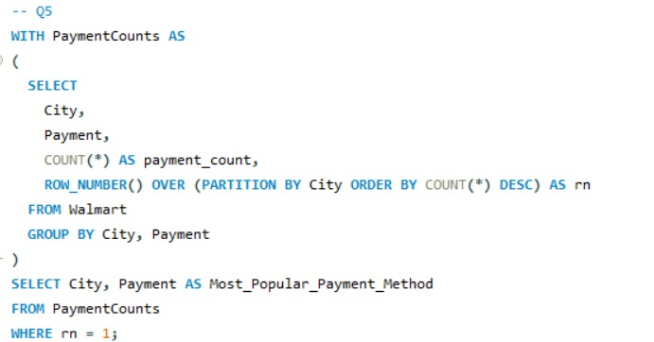
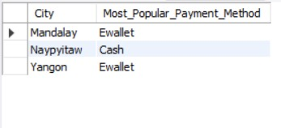
Most popular payment method by City

Slide 8
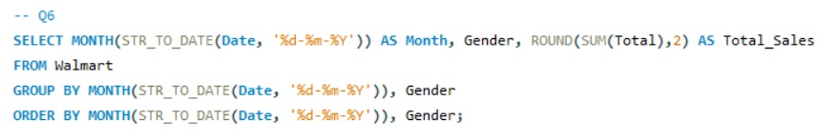
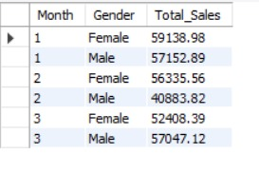
Monthly Sales distribution by Gender

Slide 9
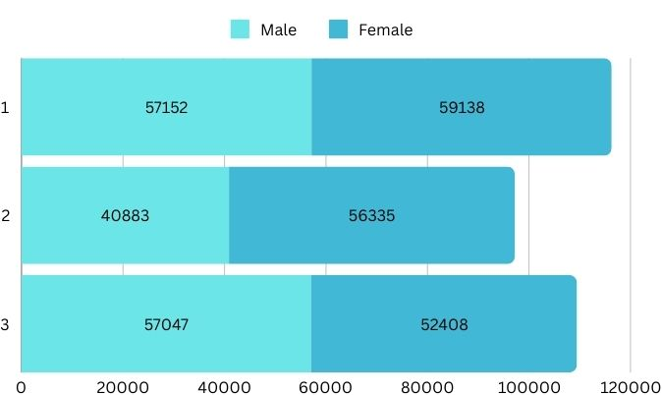
Monthly Sales distribution by Gender

Slide 10
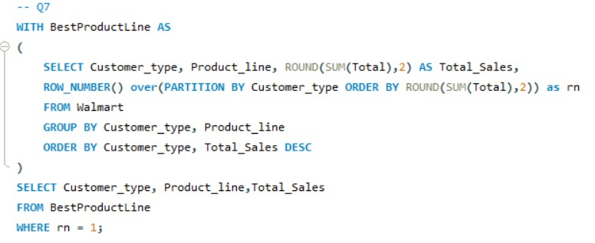
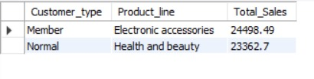
Best Product Line by Customer Type

Slide 11
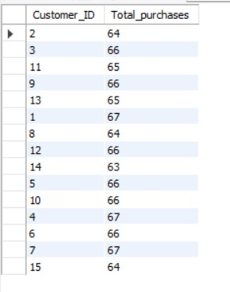
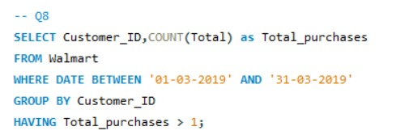
Identifying Repeat Customers

Slide 12
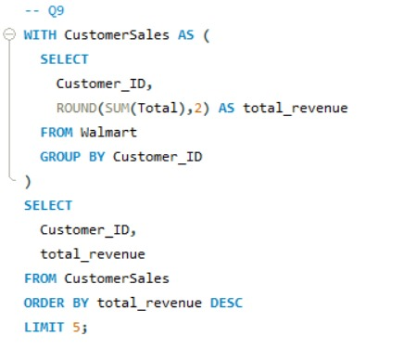
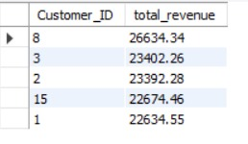
Finding Top 5 customers by Sales

Slide 13
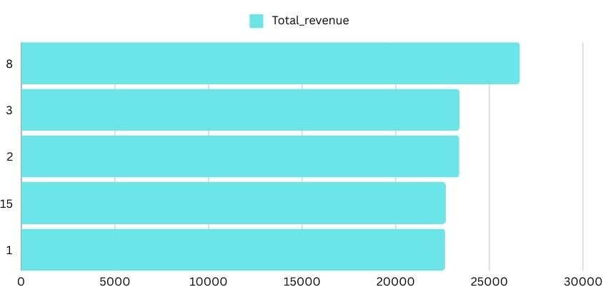
Top 5 customers by Sales

Slide 14
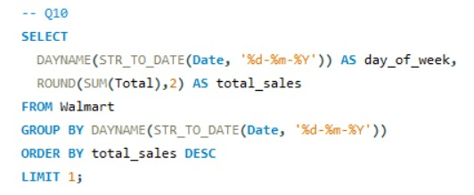

Analysing Sales Trends by Day of the Week

Slide 15
Video Explanation
Explanation of outcomes and my understanding
The suggestions to optimise the Sales strategies
Video

Slide 16
Thank you
Presented by: Karthikeya D

